Slide 1
Ethics
Presented by
Khoa Tran

Slide 2
Sections Covered
1.5 Information Technology Issues
2.1 Introduction to Ethics
2.2 Subjective Relativism
2.3 Cultural Relativism

Slide 3


1. 5 Information Technology Issues
Information technology (IT) refers to devices used in the creation, storage, manipulation, exchange, and dissemination of data, including text, sound, and images.
The cost of IT devices are falling while their capabilities continue to increase.
Wikipedia Motorola Razr V3i SamSung.com Galaxy S7
Retrieved from https://en.wikipedia.org/wiki/Motorola_Razr Retrieved from http://www.samsung.com/us/explore/galaxy-s7- features-and-specs/dist/assets/img/module1/intro.jpg
Notes:
How presentation will benefit audience: Adult learners are more interested in a subject if they know how or why it is important to them.
Presenter’s level of expertise in the subject: Briefly state your credentials in this area, or explain why participants should listen to you.

Slide 4
1. 5 Information Technology Issues (cont.)
For many items of value, making the original copy is expensive, but making copies of the original is inexpensive.
When employees use IT devices in their work, companies can monitor their actions closely.
IT capabilities are leading to changes in the IT industry itself. Silicon Valley used to be the epicenter of the IT industry, but improvements in the speed and reliability of communication networks have led to a more decentralized landscape.
US-based software companies are doing more development in countries where salaries are much lower, such as India, China, and Vietnam
Notes:
Lesson descriptions should be brief.

Slide 5
2.1 Introduction
A society is an association of people organized under a system of rules designed to advance the good of its members over time
Morality is rules of conduct describing what people ought and ought not to do in various situation.
Ethics is the philosophical study of morality, a rational examination into people’s moral beliefs and behavior.
Notes:
Example objectives
At the end of this lesson, you will be able to:
Save files to the team Web server.
Move files to different locations on the team Web server.
Share files on the team Web server.

Slide 6
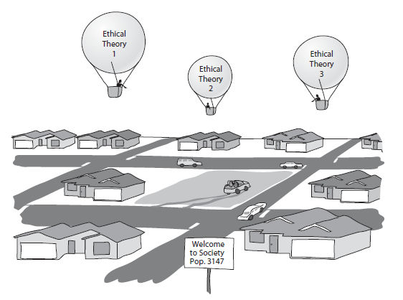
2.1 Introduction (cont.)
Society is like a town full of people driving cars
Morality is the road network within the town
The people in the Balloon are those who choose to do “ethics”
Figure 2.2 Retrieved from Ethics for Information age

Slide 7
Overview of Ethical Theories
The formal study of ethics goes back at least 2,400 years, to the Greek philosopher Socrates.
In the past two millennia, philosophers have proposed many ethical theories. In Chapter 2, we will consider nine ethical theories - nine frameworks for moral decision making

Slide 8
2.2 Subjective Relativism
Relativism is the theory that there are no universal moral norms of right and wrong. According to this theory, different individuals or groups of people can have completely opposite views of a moral problem, and both can be right.
Subjective relativism holds that each person decides right and wrong for himself or herself. This notion is captured in the popular expression, “What’s right for you may not be right for me.”

Slide 9
2.2.1 The Case for Subjective Relativism
Well-meaning and intelligent people can have totally opposite opinions about moral issues.
Ethical debates are disagreeable and pointless.
When faced with a difficult moral problem, who is to say which side is correct? If morality is relative, we do not have to try to reconcile opposing views. Both sides are right

Slide 10


2.2.2 The Case against Subjective Relativism
With subjective relativism the line between doing what you think is right and doing what you want to do is not sharply drawn.
By allowing each person to decide right and wrong for himself or herself, subjective relativism makes no moral distinction between the actions of different people.
Subjective relativism and tolerance are two different things.
We should not give legitimacy to an ethical theory that allows people to make decisions based on something other than reason.
Hitler Mother Teresa
Retrieved from Retrieved from
http://www.britannica.com http://whhspatriotpress.com/
/biography/Adolf-Hitler 3892/news/mother-teresa-made-a- saint/

Slide 11
2.3 Cultural Relativism
Cultural relativism is the ethical theory that the meaning of “right” and “wrong” rests with a society’s actual moral guidelines.
In the modern era, anthropologists have collected evidence of societies with moral codes markedly different from those of the societies of Europe and North America.
Notion of right and wrong Vary widely from one society to another. Charles Hampden-Turner and Fons Trompenaars conducted a modern study.

Slide 12
2.3.1 The Case for Cultural Relativism
Different social contexts demand different moral guidelines.
It’s unrealistic to assume that the same set of moral guidelines can be expected to work for all human societies in every part of the world for all ages.
It is arrogant for one society to judge another.
There are many important differences among societies with respect to what they consider proper and improper moral conduct.

Slide 13
2.3.2 The Case against Cultural Relativism
Just because two societies do have different views about right and wrong doesn’t imply that they ought to have different views.
Cultural relativism does not explain how an individual determines the moral guidelines of a particular society.
Cultural relativism does not explain how to determine right from wrong when there are no cultural norms.
Cultural relativism does not do a good job of characterizing actions when moral guidelines evolve.

Slide 14
2.3.2 The Case against Cultural Relativism (cont.)
Cultural relativism provides no framework for reconciliation between cultures in conflict.
The existence of many acceptable cultural practices does not imply that any cultural practice would be acceptable.
Judging many options to be acceptable and then reaching the conclusion that any option is acceptable is called the many/any fallacy.
Societies do, in fact, share certain core values.
Cultural relativism is only indirectly based on reason.

Slide 15
Preference
Quinn, M. J. (2014). Ethics for the information age (6th ed.). Upper Saddle River, NJ: Addison-Wesley.

